Slide 1
Data Splash / Region-aires!

Slide 2
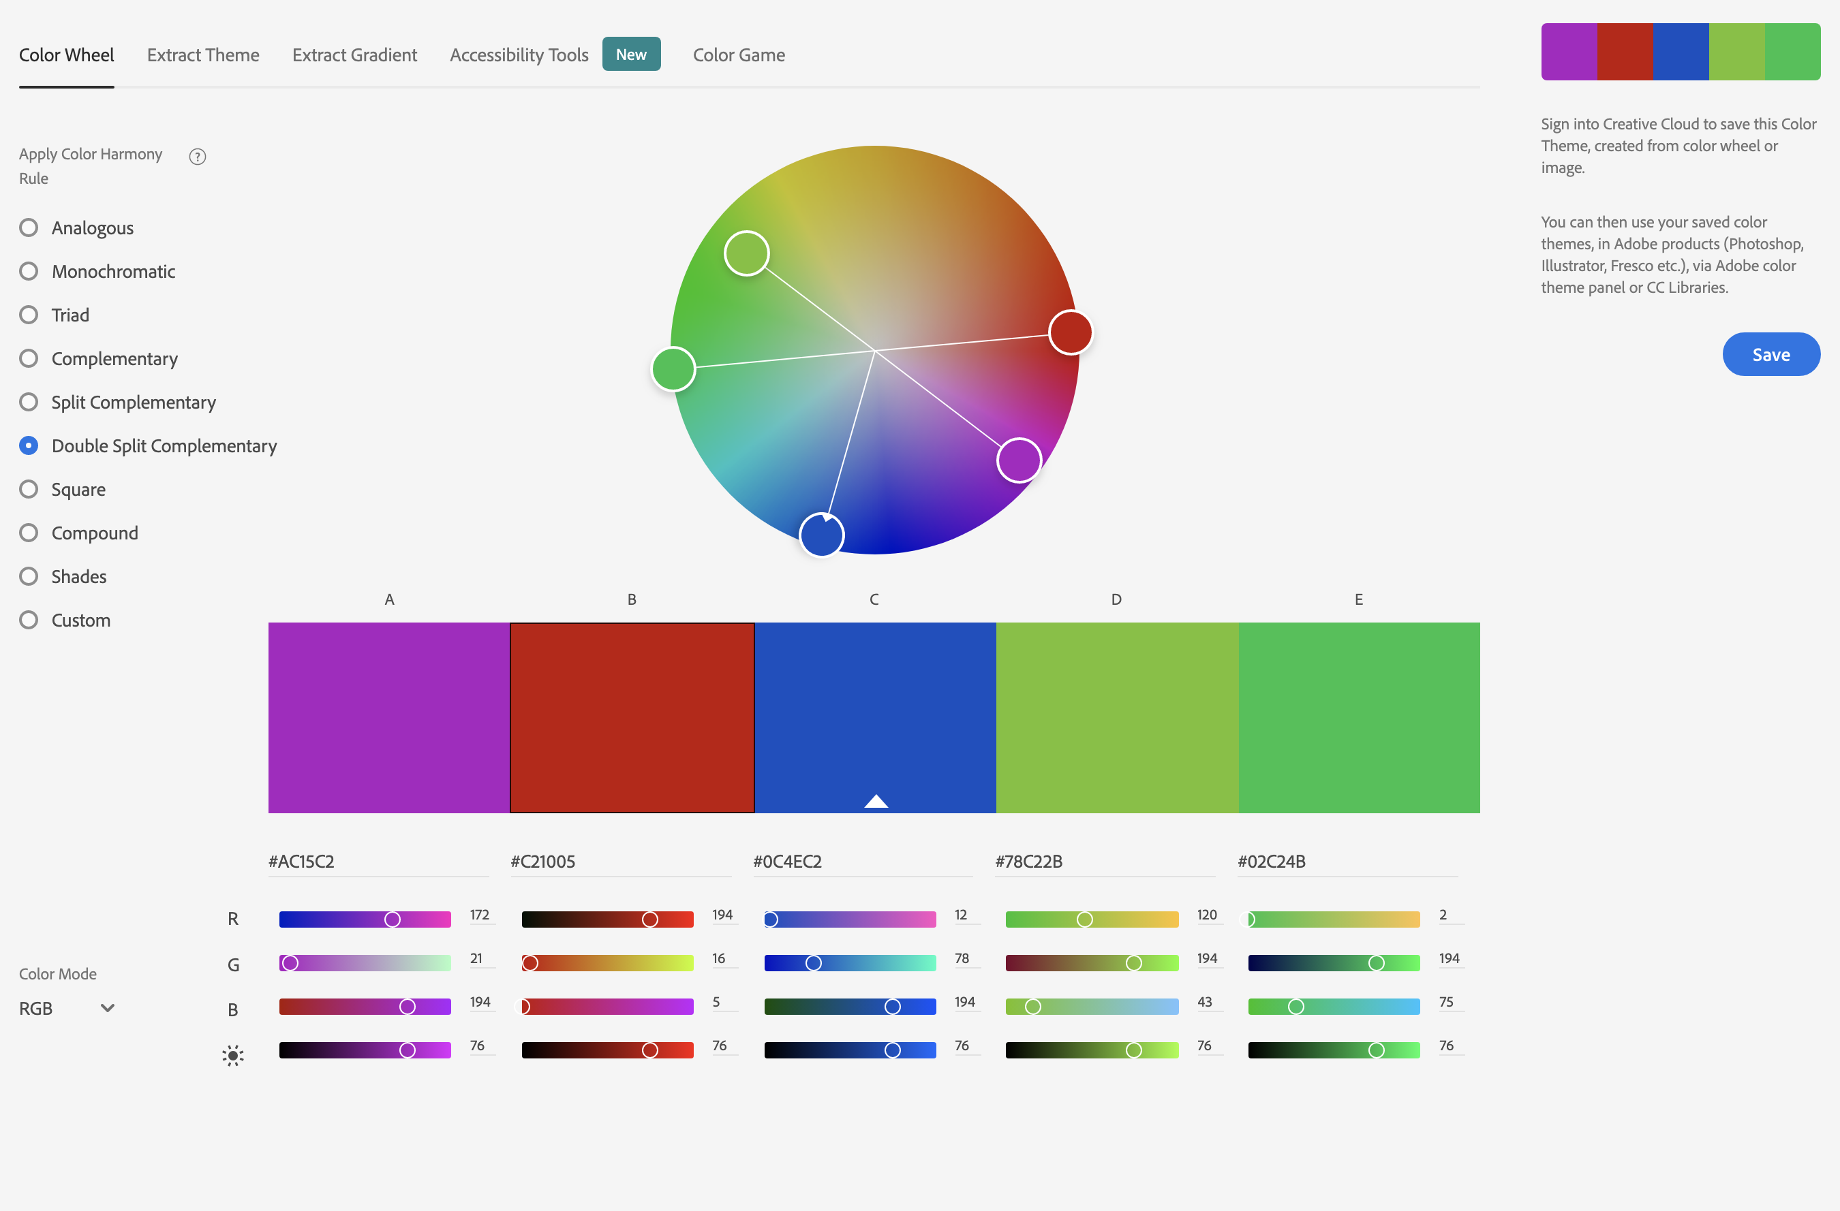
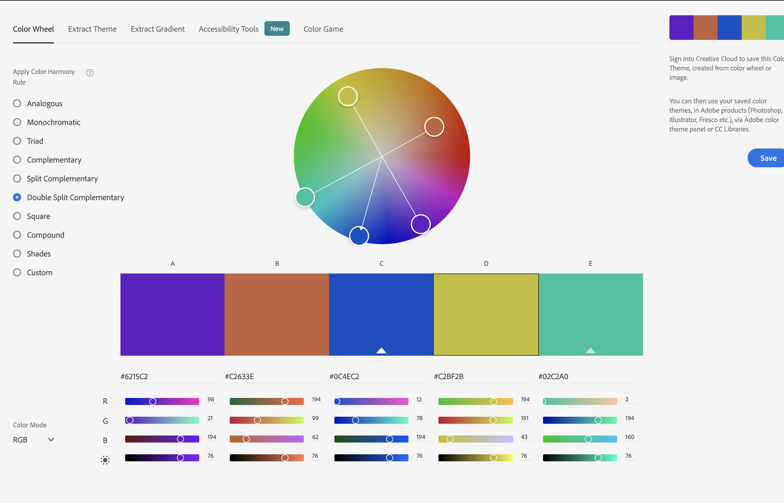
Colour Scheme

Slide 3
Splash Screen

Slide 4
Main Menu

Slide 5
Pre-Game Screen

Slide 6
Linear Regression Game Screen

Slide 7
Kmeans Game Screen

Slide 8
Learning Zone (Web Browser)

Slide 9
Free Play Area

Slide 10
Awards Screen (Gamification Badges)

Slide 11
Credits Screen? Maybe?

